Slide 1
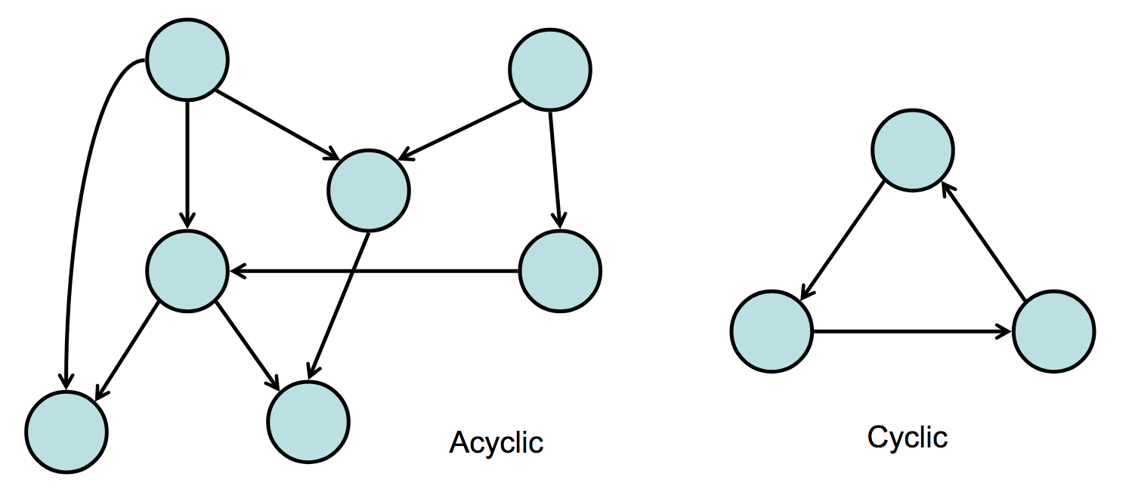
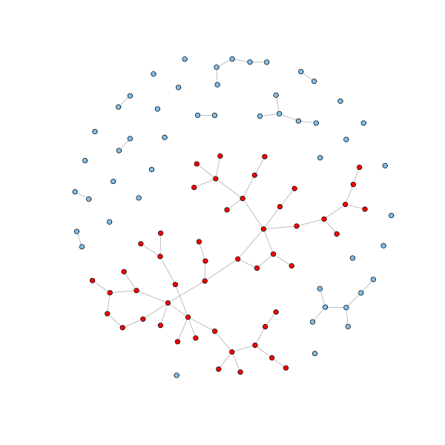
At first glance
Cyclic vs acyclic
DAG stands for Directed Acyclic Graph
Trees are undirected graphs with no cycles
Nodes can sometimes have self loops
Connected components
Set of connected nodes
Can have multiple connected components
Giant component – a component that includes the majority of nodes in the graph
Properties of the graph may have implications for various graph algorithms

Slide 2
Examples of Biological Networks
Protein-protein interaction
Metabolic
Gene Co-expression
Gene Regulatory
Genetic Interaction
Difference Networks
Abstract

Slide 3
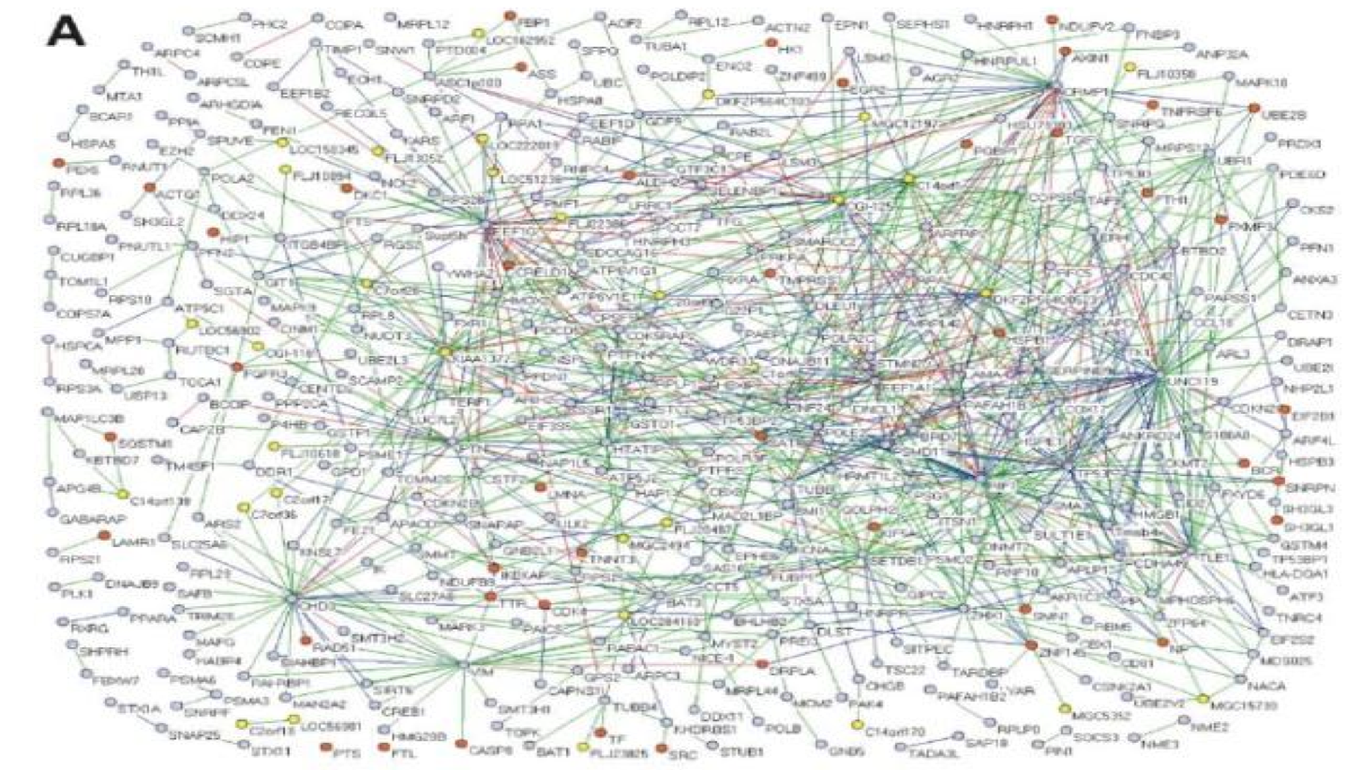
Protein Protein Interaction Network
Generated from Y2H data
MacArthur et al., PLoS ONE 3: e3086 (2008)

Slide 4
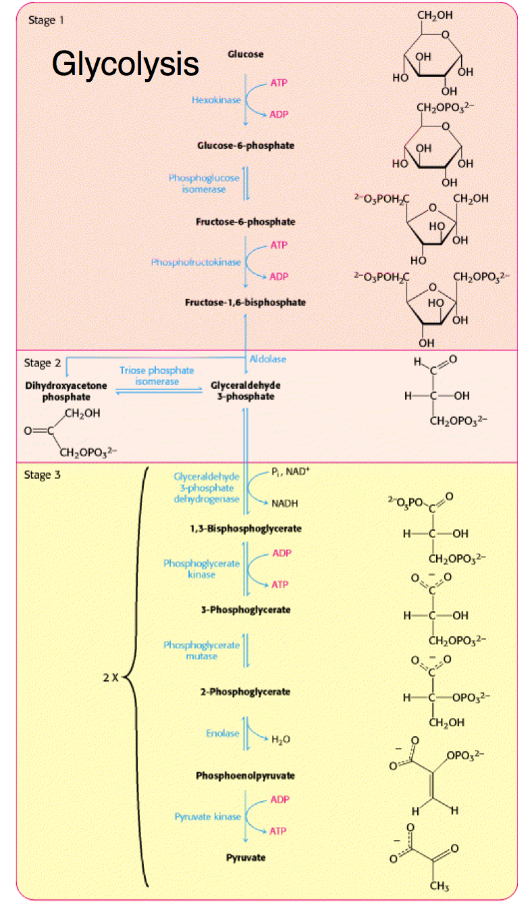
Metabolic Networks
Substrate
Reaction
Substrate
Reaction
Substrate

Slide 5
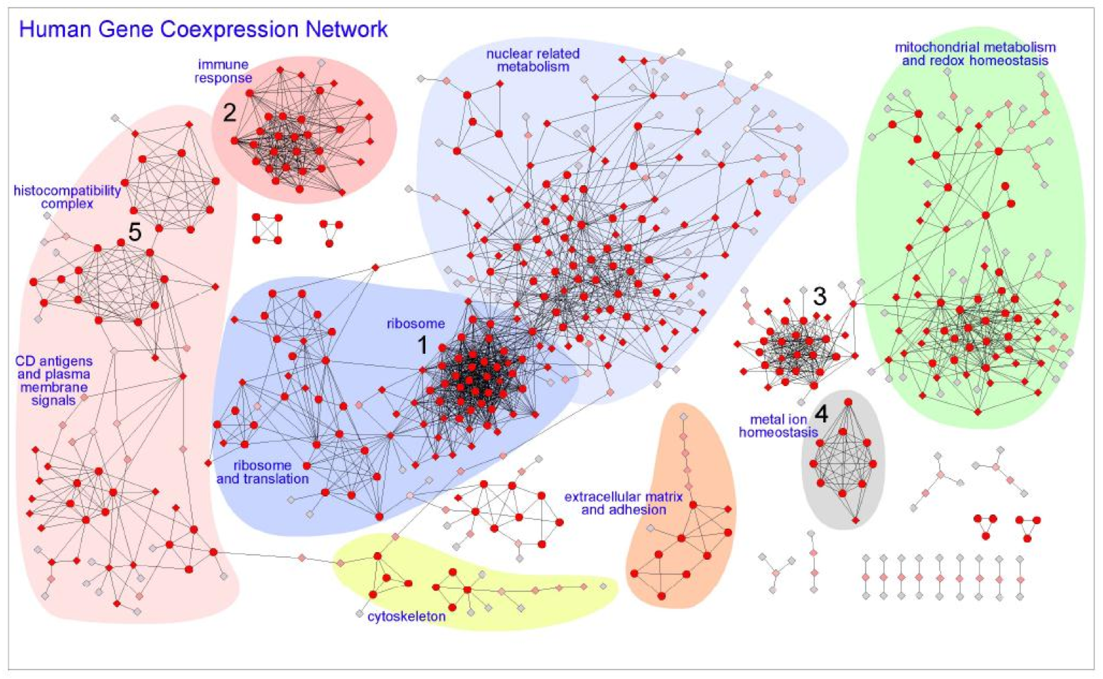
Hi-Fi Human Co-expression Network
Generated from microarrays on a panel of healthy normal tissues 3327 gene-nodes and 15841 coexpression-links
PLoS One. 2008

Slide 6
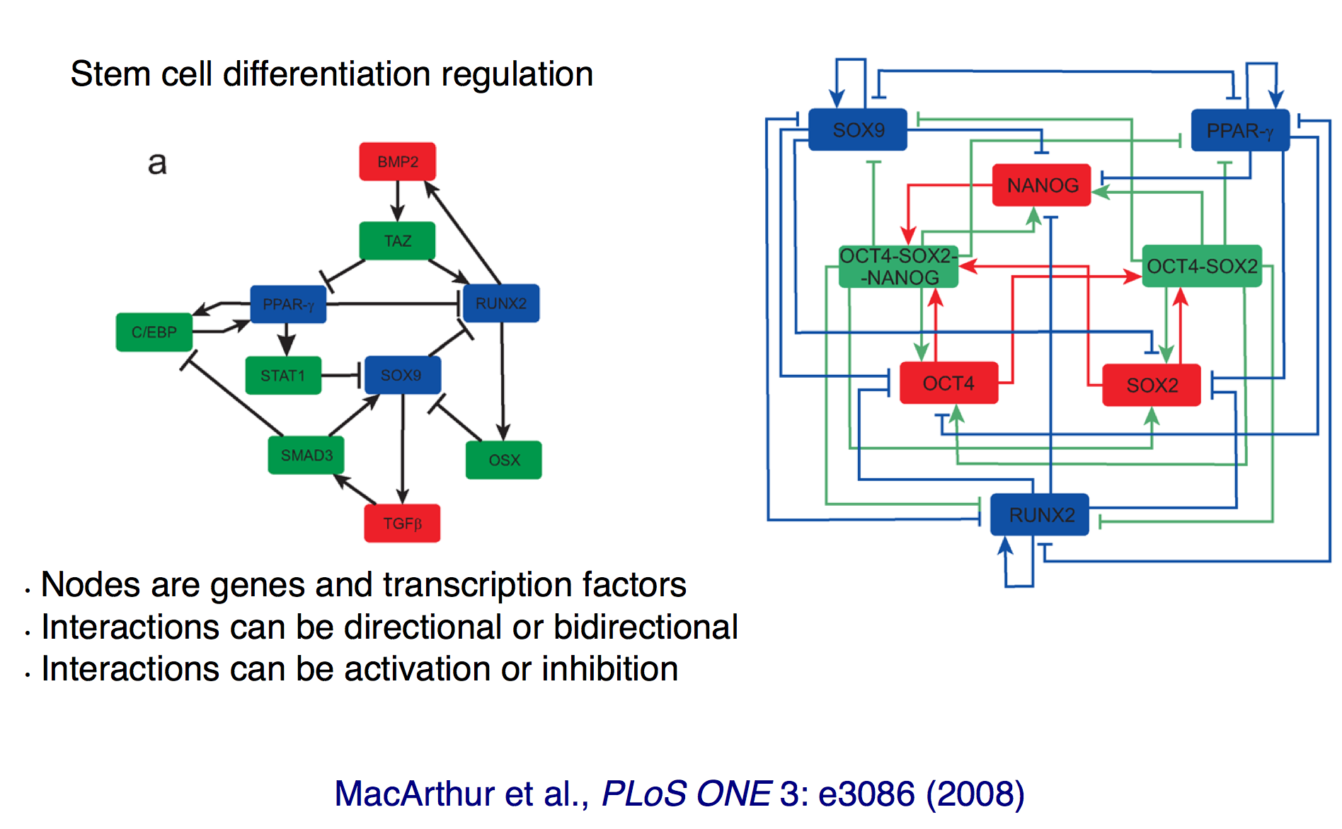
Gene Regulatory Network

Slide 7
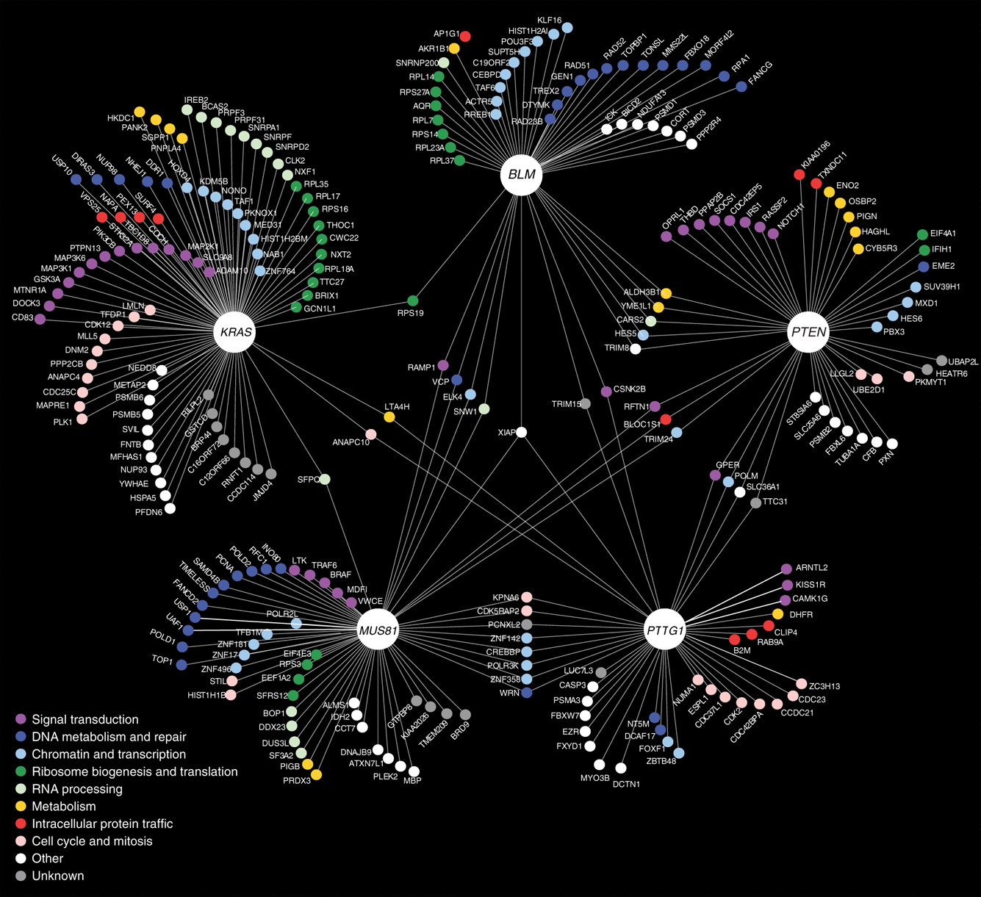
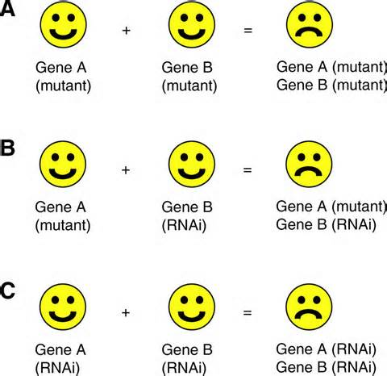
Genetic Interaction Network
Vizeacoumar et al Molecular Systems Biology (2013)
Application: Identify possible synthetic lethal interactions
Notes:
RNAi = RNA interference

Slide 8
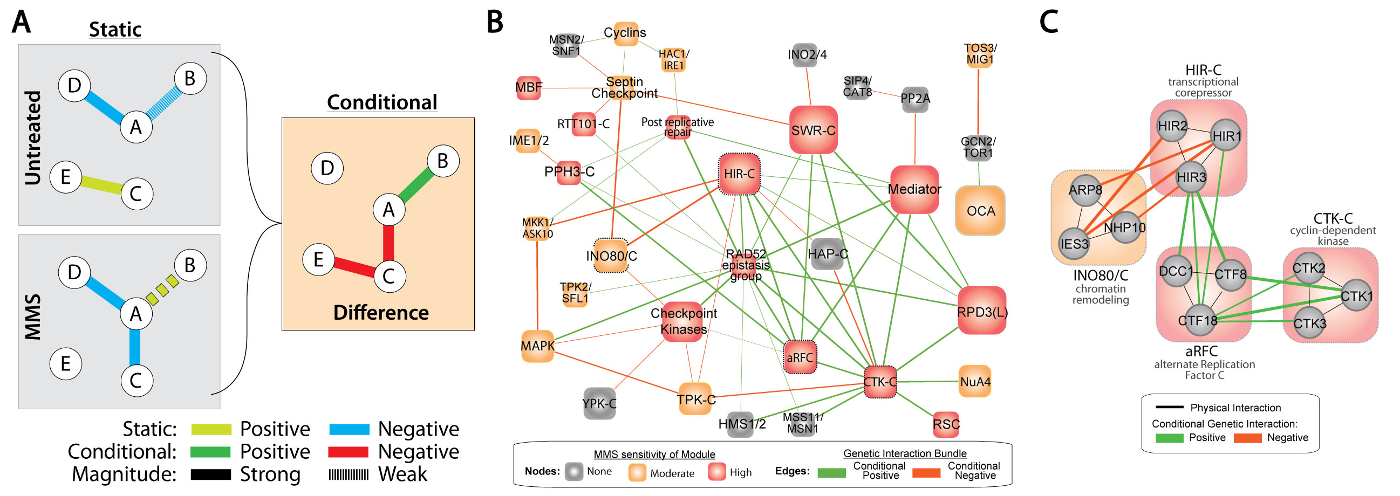
Difference Networks
Edges represent changes between different experimental conditions
Application: Compare how two distant species respond to a common stimulus

Slide 9
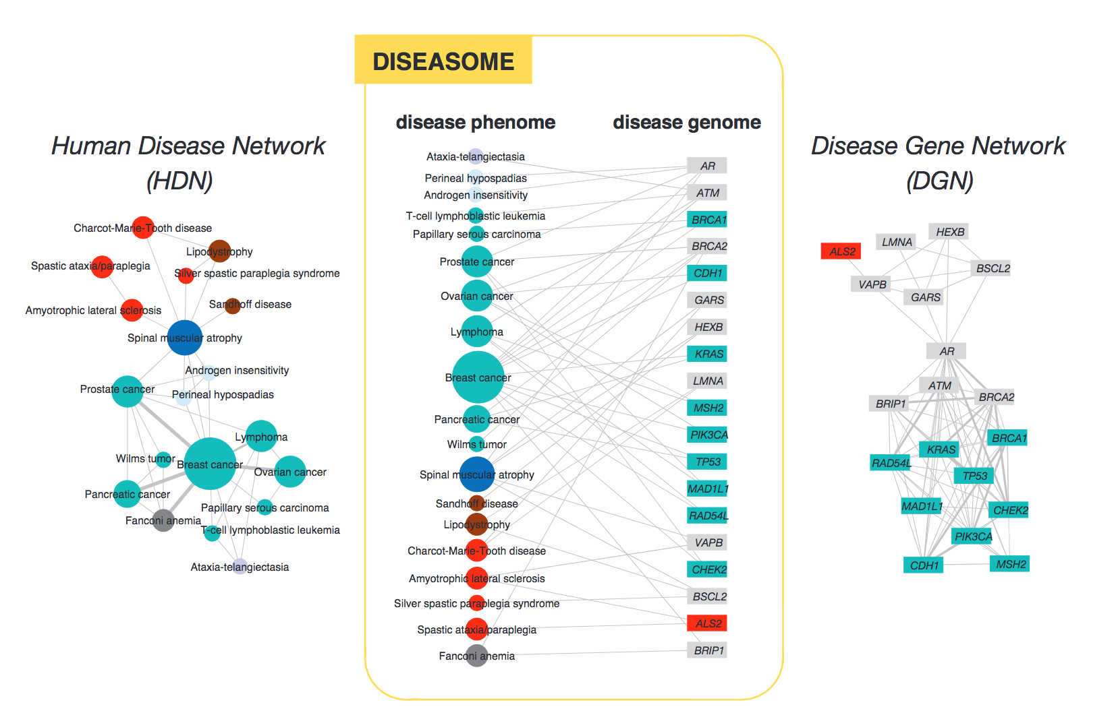
Diseaseome
Notes:
This is a collapsed view – diseases are linked by an edge if they share a gene. Node size corresponds to number of disease-associated genes

Slide 10
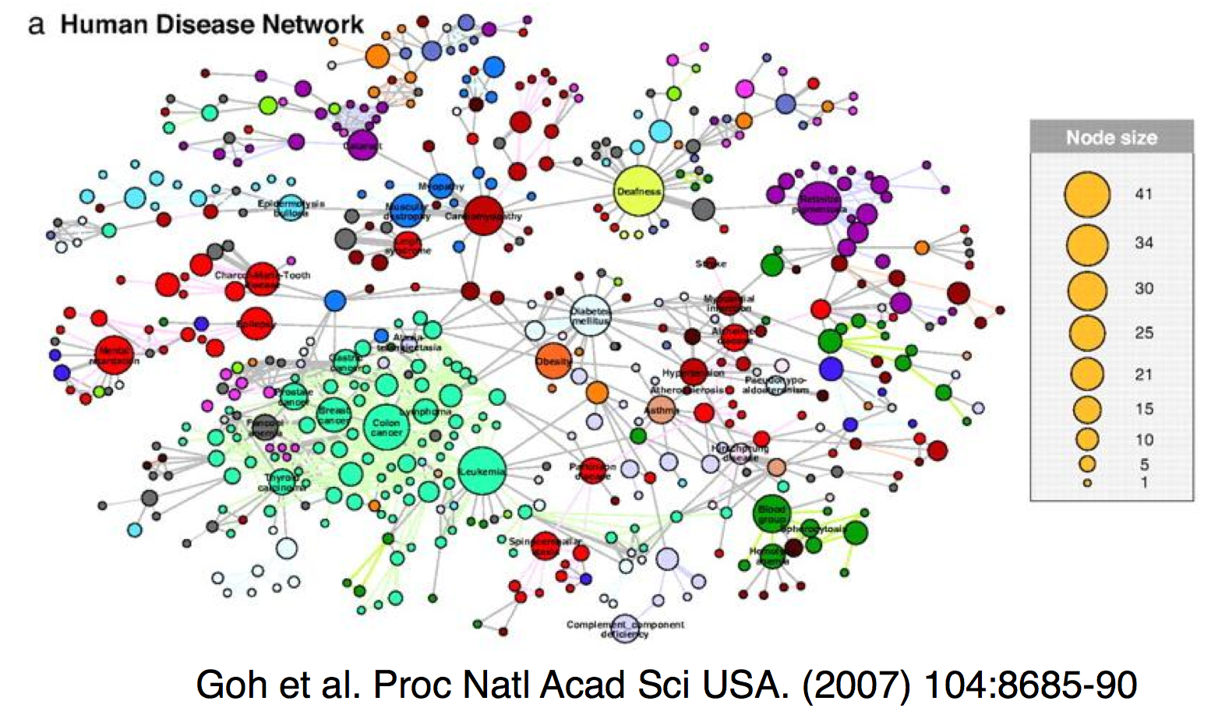
Diseaseome
Notes:
This is a collapsed view – diseases are linked by an edge if they share a gene. Node size corresponds to number of disease-associated genes

Slide 11
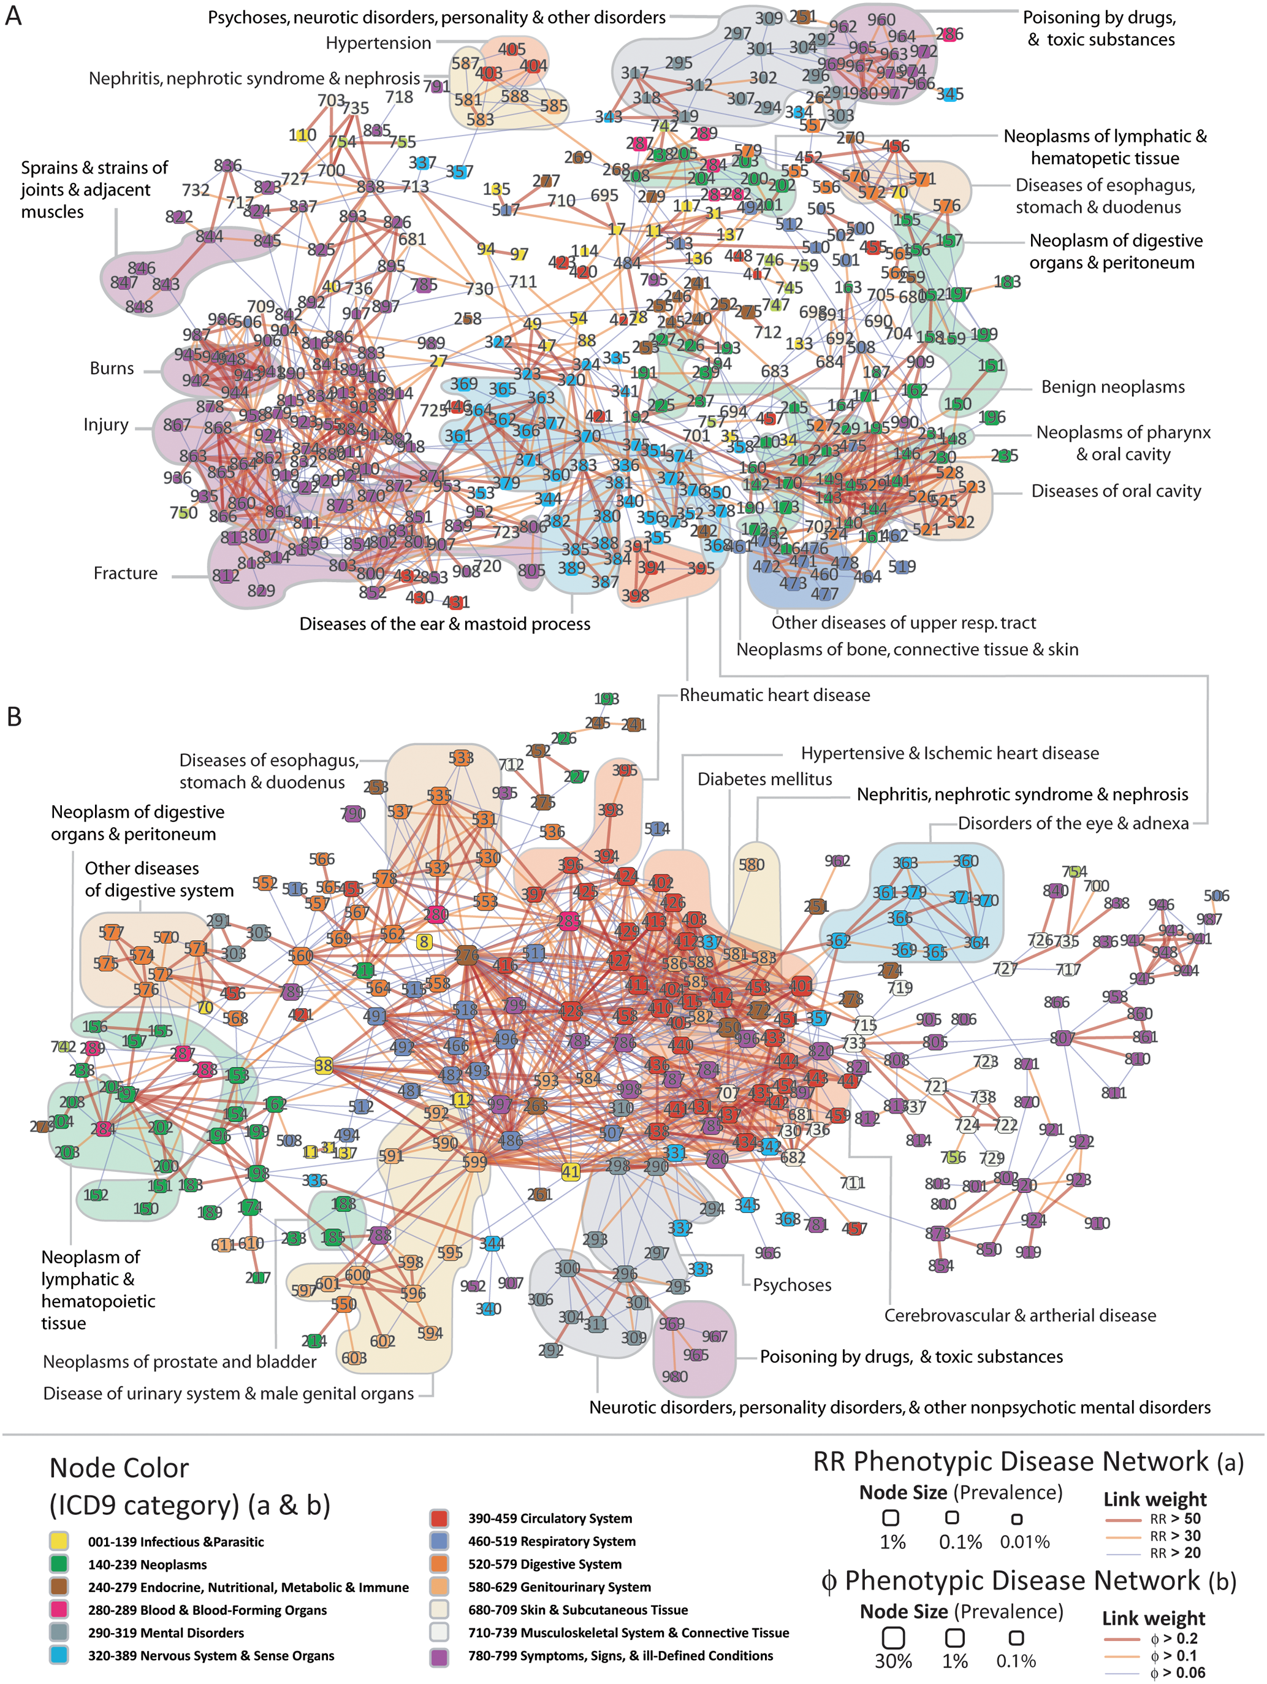
Phenotypic Disease Networks (PDNs).
Correlations obtained from the disease history of more than 30 million patients
patients develop diseases close in the network to those they already have
the progression of disease is different for patients of different genders and ethnicities;
patients diagnosed with more highly connected diseases tend to die sooner
Hidalgo et al. PLoS Comp Bio 2009

Slide 12
What can molecular networks tell us about biological systems?
Network topologies encode information about:
evolutionary constraints
function
biological information processing
vulnerabilities

Slide 13
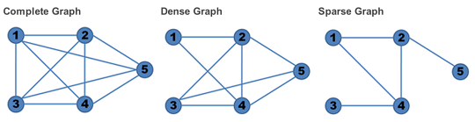
Real Networks are Sparse
A network with all possible edges between nodes (not considering self loops) is called ‘complete’

Slide 14
Characteristics of biological networks
Scale-free
– degree distribution follows a power law
Small-world
most nodes can be reached from all other nodes by traversing a small number of edges

Slide 15
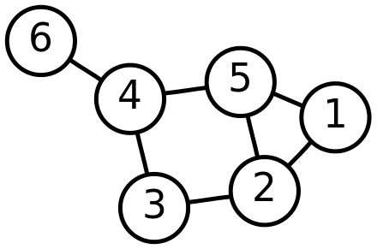
Relevant graph variables “Scale Free” property
Degree
The number of edges incident on a node
In a directed graph can be divided into in-degree and out-degree
High degree nodes called ‘hubs’

Slide 16
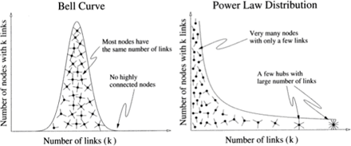
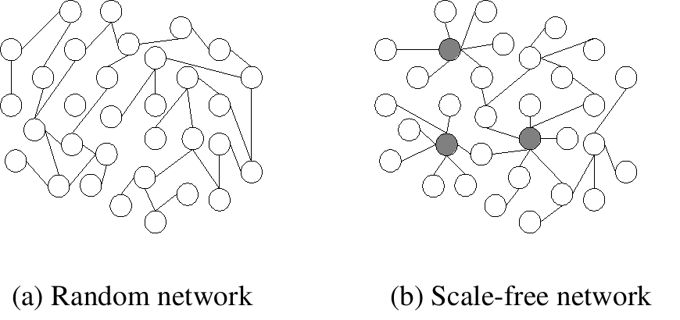
Scale Free Networks
Implications for error tolerance:
P(deg=k) - k more likely to be higher in random network
More tolerant to random failures
“Attacks” targeting higher degree nodes more likely to be disruptive to function

Slide 17
Hubs are common in biological networks
PPI networks, regulatory networks and many other biological networks have hubs (Nodes of high degree)
PPI network hubs are older¹ and more essential² than random proteins in the network
1 Fraser et al, Science (2002)
2 Jeong et al, Nature (2001)

Slide 18
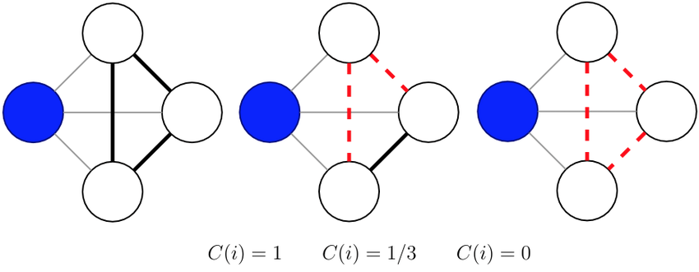
Relevant graph variables: “Small World” Property
Path
A walk in which no vertex occurs more than once
Shortest path
Diameter
Longest shortest path
Clustering Coefficient
A measure of how densely connected a graph is
Can calculate node-wise or graph-wise CC

Slide 19
Clustering Coefficient
How connected are my neighbors?
Count triangles
Denominator enumerates the possible ways a node can connect to two of its neighbors

Slide 20
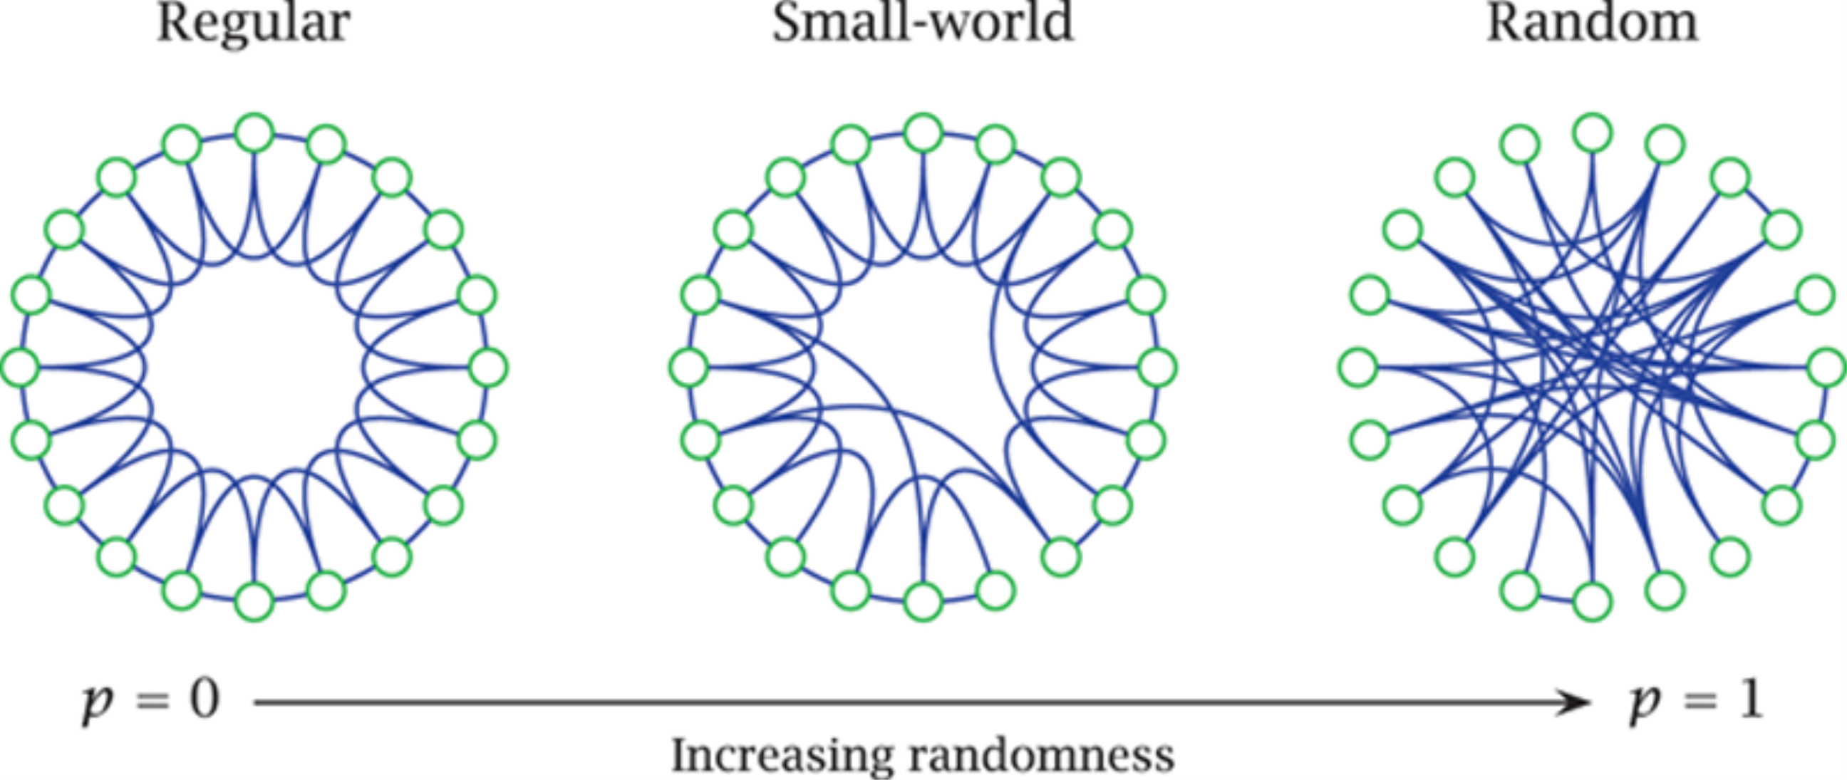
Small-world Networks
Watts & Strogatz networks (Nature 1998) illustrate the concept
A compromise between modularity and average distance to other network nodes
Higher clustering coefficient
Higher average path length
Lower clustering coefficient
Lower average path length
p = rewiring probability
Notes:
Most nodes closely related with a few nodes having connection to distant nodes

Slide 21
Small World property in real biological networks

Slide 22
Biological implications of network topology
Biological systems evolve to optimize:
Error tolerance and robustness
Dynamics and time-scale of information flow

Slide 23
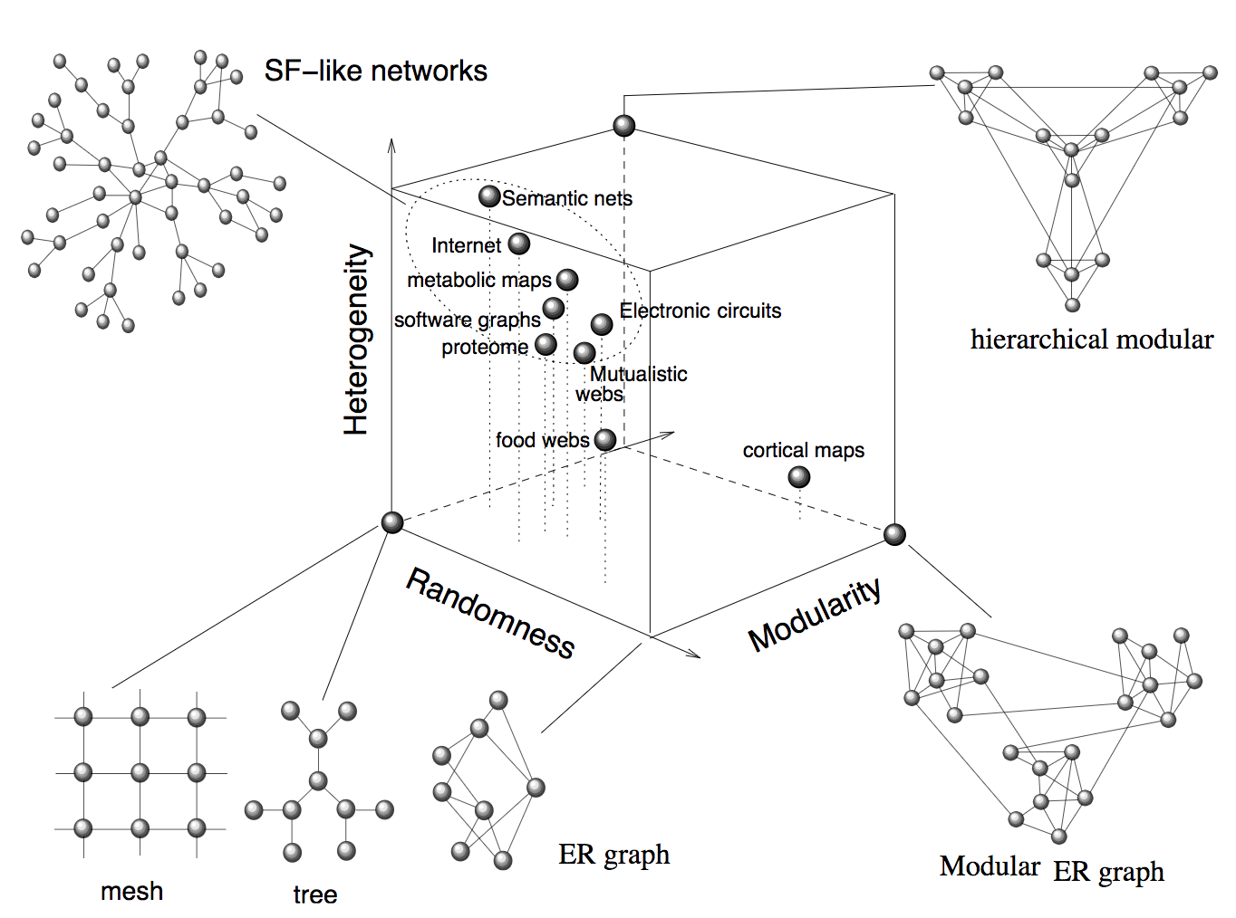
Where real network architectures fall relative to theoretical networks
Solé & Valverde (2004)

Slide 24
Implications of network architecture for disease
The architecture of a graph determines the severity of a perturbation to a node or edge
Can node/edge level features inform the potential for disease?

Slide 25
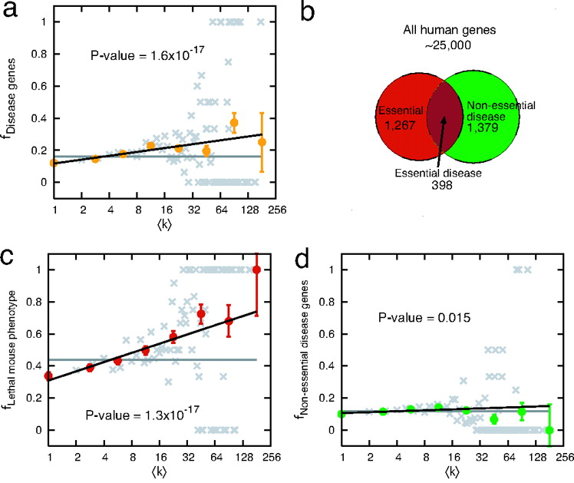
Degree of disease denes
High degree proteins more likely disease associated
Essential genes are much more likely to be hubs
Kwang-Il Goh et al. PNAS 2007;104:8685-8690
Notes:
High degree proteins show a tendency to be disease associated
But this is driven by the 22% of disease genes that are also essential genes
Essential genes are strongly biased towards hubs
When Essential genes are removed, there is no apparent bias towards hubs for disease genes
Gray – data binned on linear scale, color – data binned on log scale

Slide 26
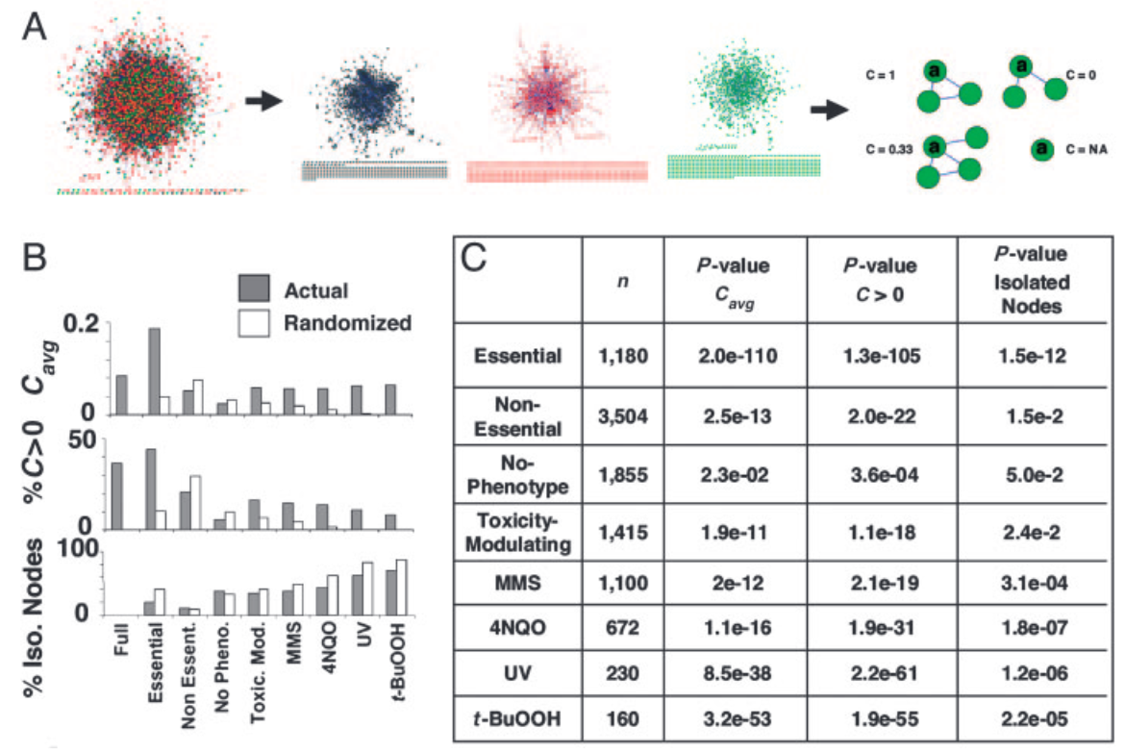
Edge density versus phenotype
Clustering Coefficient
Essential genes have higher C(v)
Actual
Randomized
0.2
C(V) avg
0
Full Essential
Non Essent.
No Pheno.
Toxic. Mod.
Said et al PNAS 2004
Notes:
Essential, toxicity-modulating, and no-phenotype classifications were based on results obtained by the S. Cerevisiae Gene deletion consortium

Slide 27
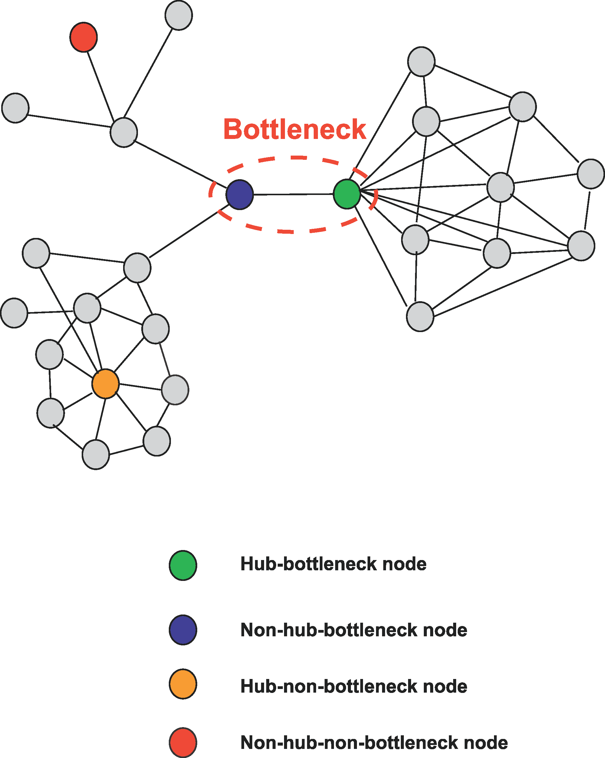
Topology versus information flow
Bottlenecks: nodes with high centrality
Can have low or high degree
Centrality-Lethality Hypothesis
The more central a gene/protein is, the more likely it is essential
Yu et al Plos Comp Bio 2007

Slide 28
Network centrality features
Degree: How many nodes can this node reach directly?
Betweenness: How likely is this node to be the most direct route between two nodes in the network?
Closeness: How fast can this node reach all nodes in the network?
Eigenvector: How well is this node connected to other well-connected nodes?
(bottleneck)
(central)
(connected to other hubs)
(hub)
Notes:
Old:
Degree: the number of interacting partners of a protein
Betweenness: are they in the shortest path of other nodes? (bottlenecks)
quantifies the number of times a node acts as a bridge along the shortest path between two other nodes
The betweenness centrality of a node reflects the number of shortest paths (geodesics) from all nodes to all others that pass through it
Closeness: the average length of the shortest path between the node and all other nodes in the graph
Eigenvector: a measure of the influence of a node in a network
quantifies each protein’s connectedness to high degree proteins (hubs)
In conclusion: we looked at some network centrality features that show how influential these nodes are in the network
It looks like candidate genes definitely have a similar profile to known drivers (especially TS) compared to rest
This also shows the premise of these candidate driver genes to perturb PPI networks

Slide 29
Node centrality measures
Degree centrality
normalized
Closeness centrality
Eigenvector centrality
normalized eigenvector of first eigenvalue of the adjacency matrix
Intuition: A nodes importance depends on the importance of its neighbors
Betweenness centrality

Slide 30
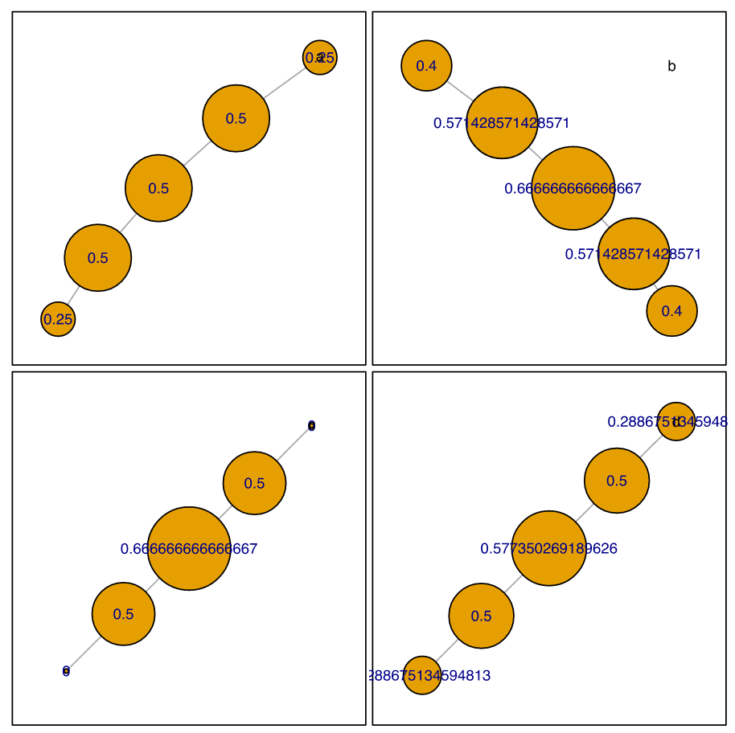
Node centrality measures
Different node weight distributions for the same graph
Degree
Closeness
Betweenness
Eigenvector

Slide 31
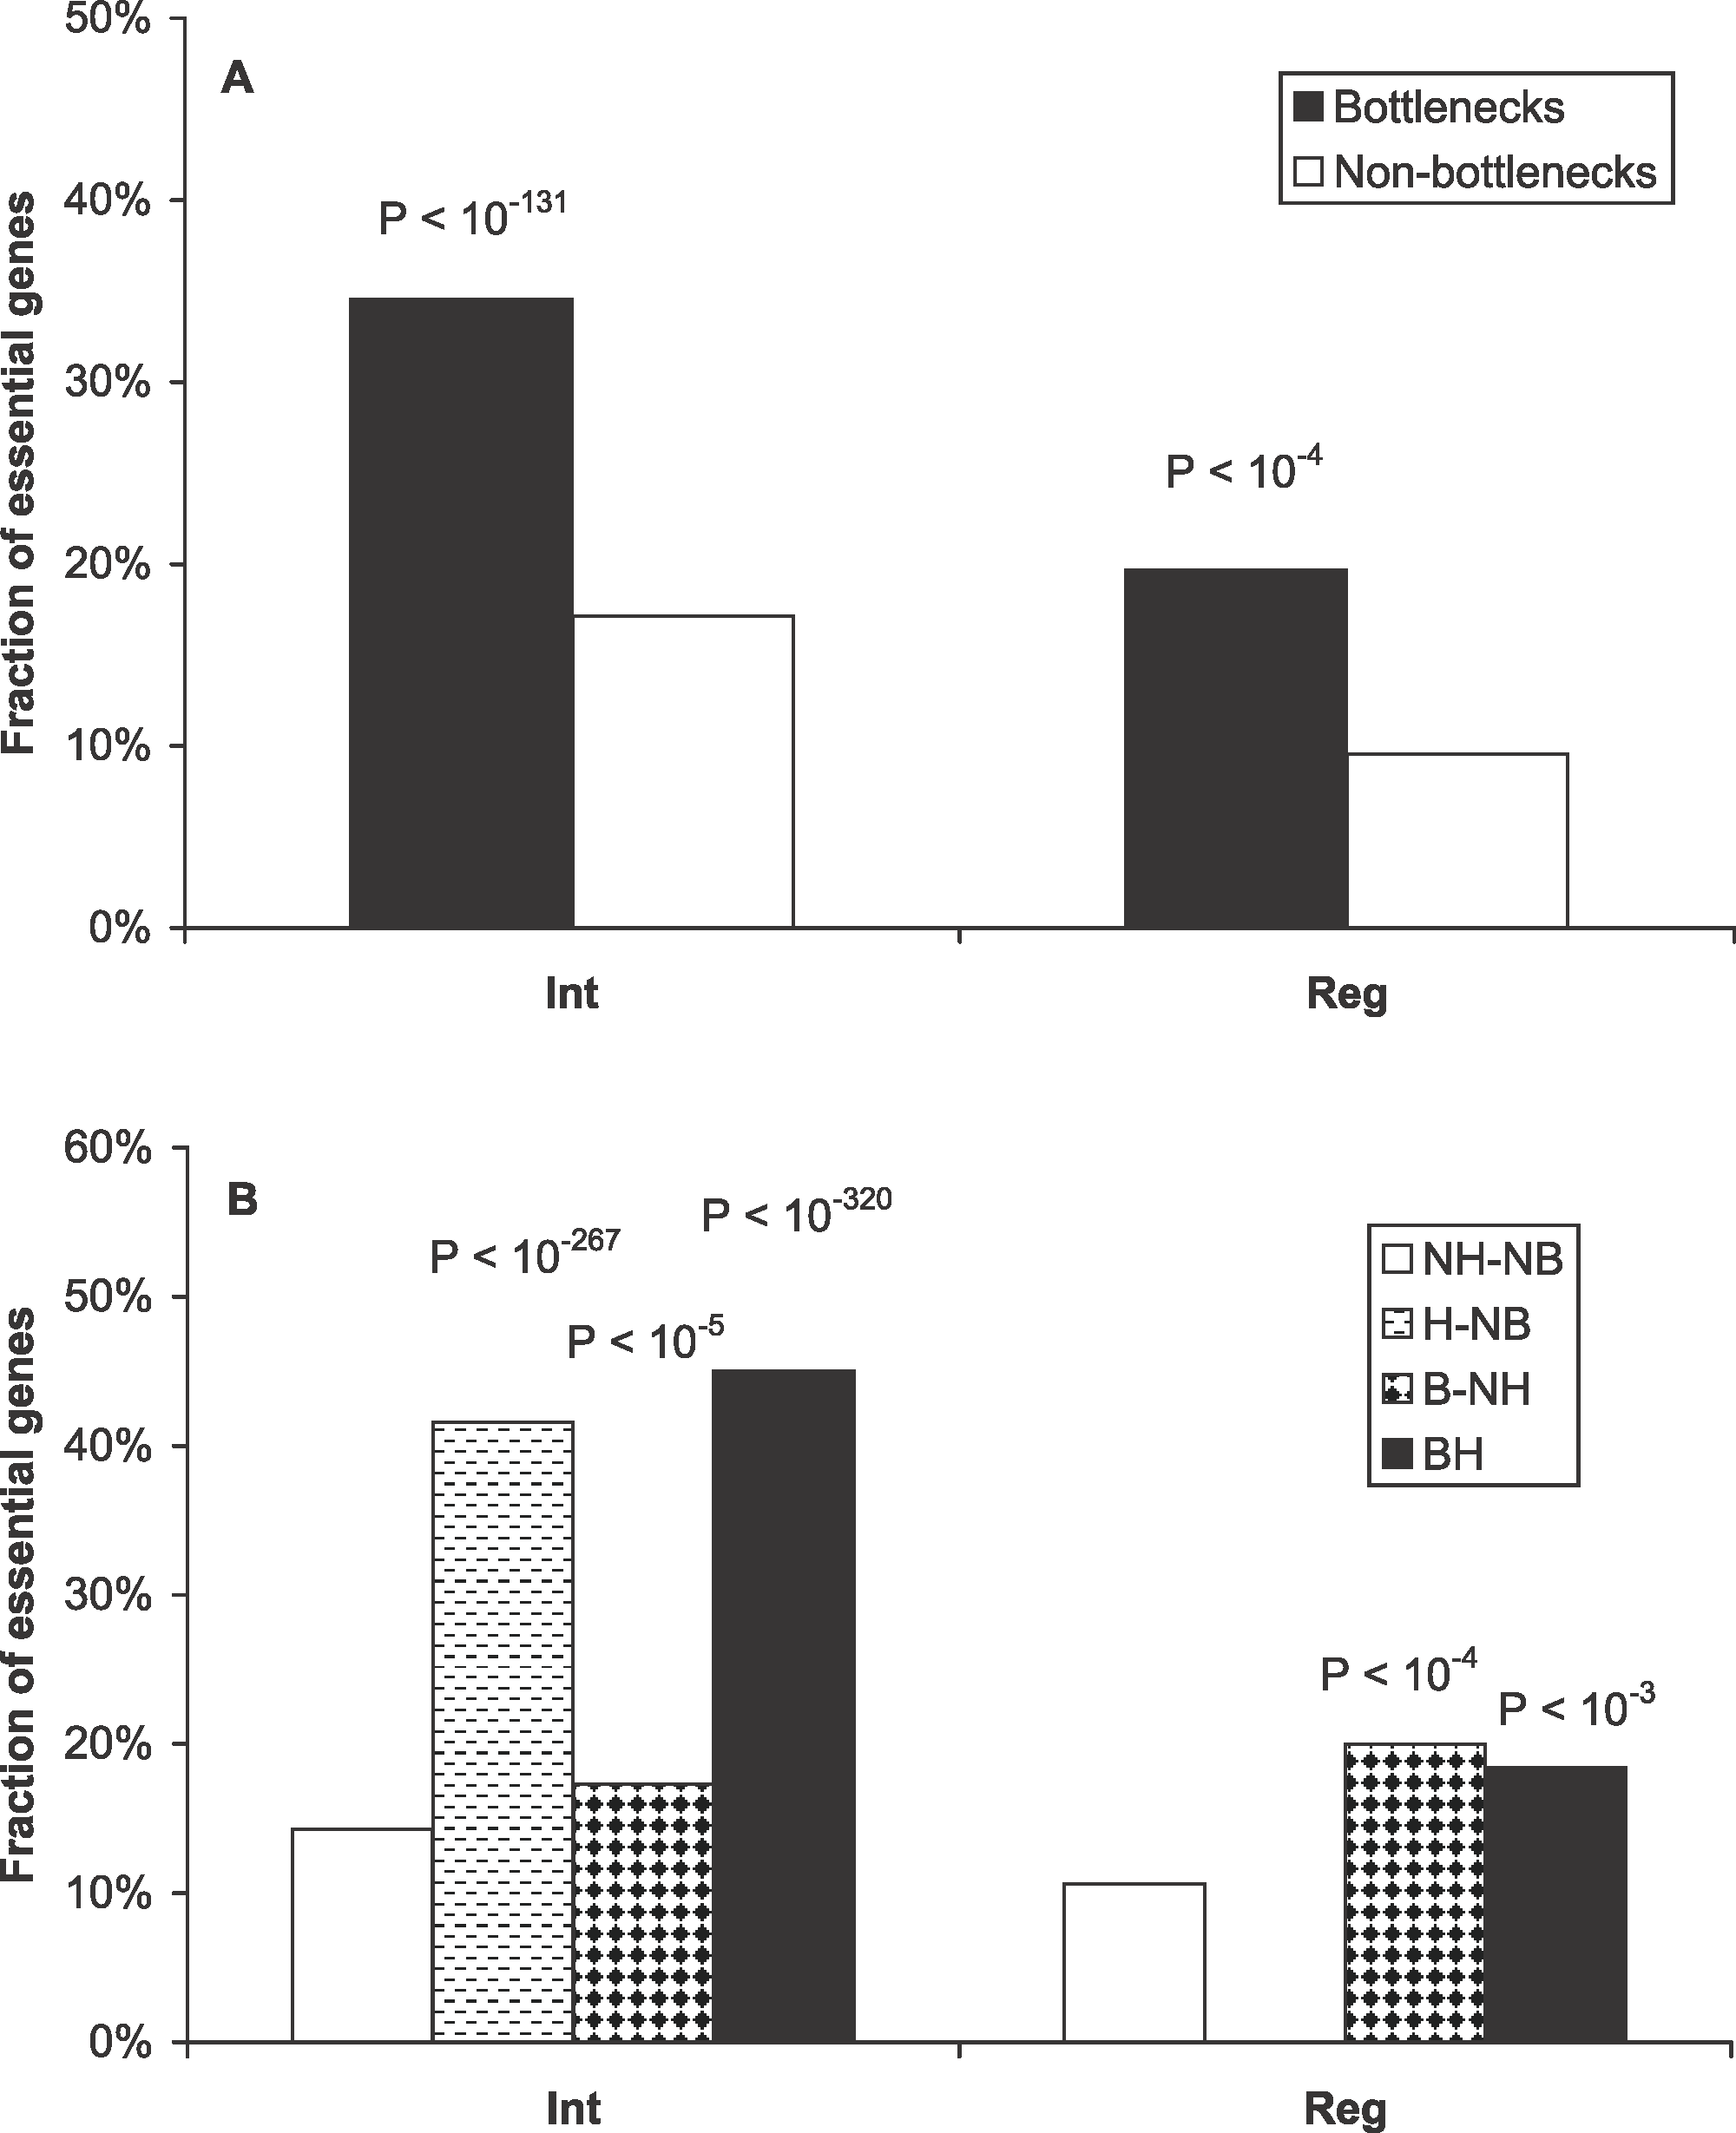
Node centrality in biology
Bottlenecks: nodes with high centrality
Can have low or high degree
Centrality-Lethality Hypothesis
The more central a gene/protein is, the more likely it is essential
Yu et al Plos Comp Bio 2007
Notes:
A) Bottlenecks tend to be essential genes in both interaction and regulatory networks. p-Values measure the statistical significance of the different essentialities between bottlenecks and nonbottlenecks.
(B) Essentiality of different categories of proteins. NH-NB, nonhub–nonbottlenecks; H-NB, hub–nonbottlenecks; B-NH, nonhub–bottlenecks; BH, hub–bottlenecks. p-Values measure the statistical significance of the different essentialities between different categories of proteins against nonhub–nonbottlenecks using cumulative binomial distributions

Slide 32
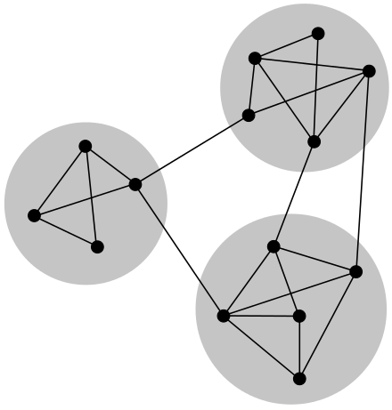
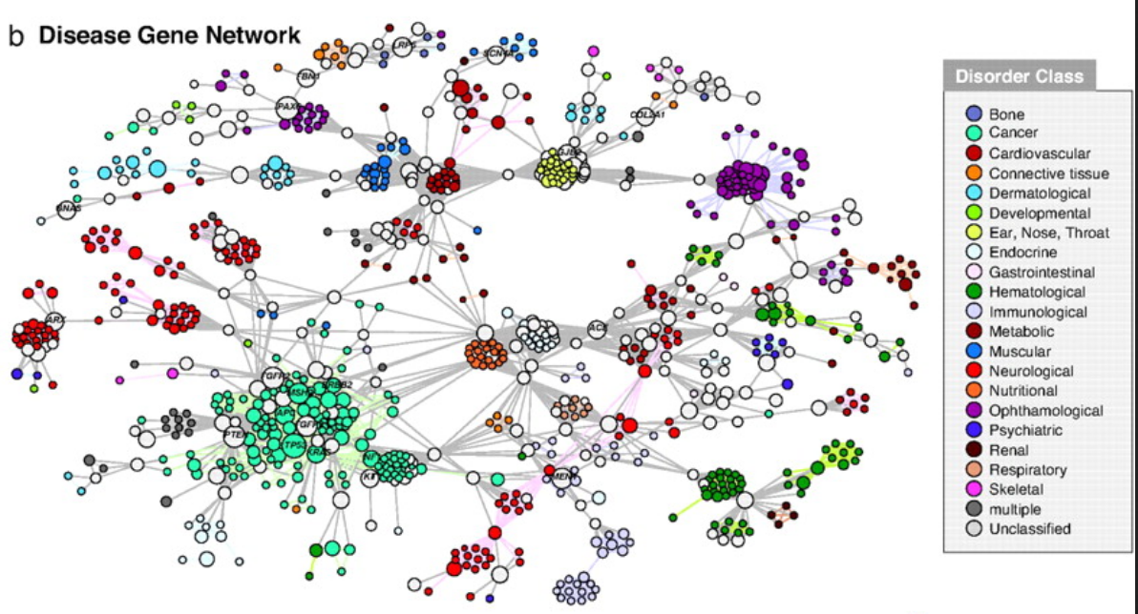
Modularity in Biological Networks
Groups of more highly connected nodes
Tend to be more functionally related
Guilt-by-association

Slide 33
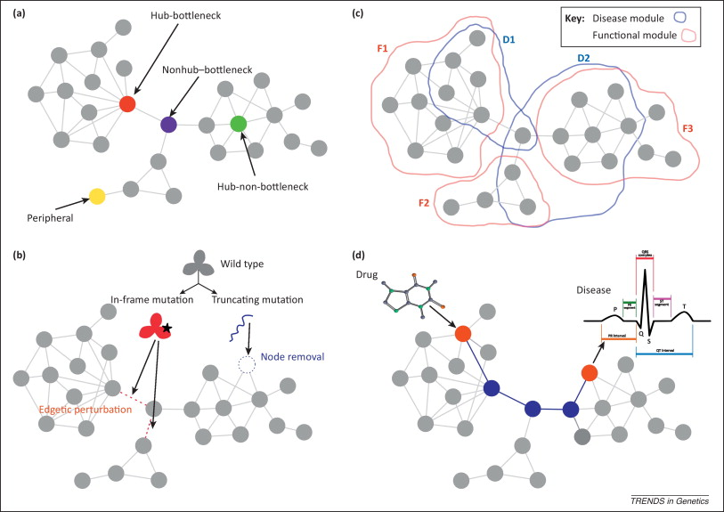
Network properties of human disease genes
Topology
Modularity
Perturbation
Gene X Environment
Furlong L. Human diseases through the lens of network biology Trends in Genetics 2013
Notes:
Different network attributes of disease genes are illustrated in a protein interaction network (PIN). (a) Nodes can be characterized by their role in the network, as peripheral, hubs, or bottlenecks. (b) The type of mutation of a protein (in-frame or truncating) leads to different perturbations in the PIN. Nonsense mutations, frame-shift mutations, and splice-site mutations lead to truncated proteins or completely destabilized proteins that can no longer maintain proper interactions with their protein partners. Such truncating mutations remove a node from the network and abolish all interactions. By contrast, subtle changes, such as single amino acid substitutions affecting binding sites or truncations that retain certain domains of the protein, may produce partially functional proteins that affect only a subset of their interaction partners. These in-frame mutations are referred to as edge-specific genetic, or edgetic, perturbations. (c) Different regions of a network can be identified according to the involvement of the nodes in common biological processes [functional (F) modules] or the same disorder [disease (D) modules]. Note that there is not a perfect overlap between functional and disease modules. In addition, different disease modules may overlap at least in part due to shared genetic determinants. (d) The interplay between environmental factors and genetic variation can be studied with network analysis. For example, the relation between the target of a drug and the protein associated with an adverse effect is modeled by calculating a distance measure in a PIN (edges highlighted in blue).

Slide 34
Exercise: Basic network analysis with iGraph
Jupyter Notebook: Exercise 2

